Slide 1


Reinis R. Ruza
2022/11/09

Slide 2

Outline
Executive Summary
Introduction
Methodology
Results
Conclusion
Appendix

Slide 3
Executive Summary
Our startup, Space Y, has applied a data science approach to predict Falcon 9 rocket first-stage booster-retrieval rate (BRR) with high accuracy.
To do so, we utilised the SpaceX API and scraped information available online to collect information on all SpaceX launches, such as booster type, payload mass, target orbit, launch site, booster retrieval success (BRS), and others. The data was cleaned up and used for exploratory data analysis, which showed that although some parameters might influence BRS, their individual contributions to the mission outcome were low.
Because of this, we used parameter optimisation via grid search for different classification algorithms. The ones examined here were logistic regression, support vector machine, decision trees, and K-nearest neighbours. The best performing parameters for each algorithm were then used to score their performance, using an 80%/20% train/test split of our dataset. All algorithms performed equally well on the testing subset, although there were only 18 entries in it, so more data would be required to accurately estimate model accuracy

Slide 4
Introduction
The success of SpaceX by the introduction of reusable first-stage boosters has shown that the space industry can provide lucrative business opportunities. Despite its achievements, SpaceX only has a 66% booster retrieval rate (BRR), thus driving up cost of its launches.
If Falcon 9 booster retrieval success could be predicted for each mission, this would enable our startup, SpaceY, to provide more accurate costs for each mission, as well as allow our clients to make adjustments to their mission parameters based on their risk tolerance.
Therefore, the principal question of this research was –
Can we predict whether Falcon 9 booster retrieval for a specific mission will be successful, and can we do so with high accuracy?

Slide 5

Section 1

Slide 6
Methodology
Executive Summary
Data collection methodology:
SpaceX API, Web Scraping
Perform data wrangling
Data filtering, formatting, filling out missing datapoints
Perform exploratory data analysis (EDA) using visualization and SQL
Perform interactive visual analytics using Folium and Plotly Dash
Perform predictive analysis using classification models
Parameter gridsearch, evaluation of different models

Slide 7
Data Collection
SpaceX API
Past launch data downloaded using SpaceX API as a .json file using requests.get()
Web Scraping
Downloaded Falcon 9 launch Wikipedia entry using requests.get()
Converted downloaded page to a BeautifulSoup object
.json file converted into a Pandas dataframe using pd.json_normalize
Most of the past launch data, such as rocket used and launch site identified by ID – convert to real values by making further calls to the SpaceX API
Identify table containing launch data using soup.find_all(name='table')
Identify the table columns, then parse each row, adding each value into a dictionary
Finally, dictionary converted into a Pandas dataframe

Slide 8
Data Collection – SpaceX API
To collect data using the SpaceX API, made several REST calls using requests.get()
First downloaded past flight data – where parameters for each launch were identified by ID values
To obtain real values behind each ID, made 4 separate REST calls to different parts of the API
All data was stored in a dictionary, which was then converted into a Pandas dataframe
REST Call 2
Get Booster Versions
https://api.spacexdata.com/v4/rockets/
REST Call 3
Get Launchpad information
https://api.spacexdata.com/v4/launchpads/
REST Call 1
Get past flight data
https://api.spacexdata.com/v4/launches/past
REST Call 4
Get payload and target orbit data https://api.spacexdata.com/v4/payloads
REST Call 5
Get core and launch outcome information
https://api.spacexdata.com/v4/cores/
https://github.com/Leocadion/IBM-Data-Science-Final-Project/blob/main/jupyter-labs-spacex-data-collection-api.ipynb

Slide 9
Data Collection - Scraping
To obtain more information about each launch, data was scraped from Wikipedia
After downloading webpage HTML and converting it to a BeautifulSoup object, the table containing relevant info was identified
The table was then parsed and its values written into a dictionary
Finally, the dictionary was converted into a Pandas dataframe
Request the Falcon9 Launch Wiki page from its URL using requests.get() (https://en.wikipedia.org/w/index.php?title=List_of_Falcon_9_and_Falcon_Heavy_launches&oldid=1027686922
Convert response to a BeautifulSoup object
Identify the table containing Falcon 9 launch data using soup.find_all(name='table')
Identify column names using find_all(name='th’) and create an empty dictionary for all column values
Parse the table one row at a time, adding values from each column to the dictionary, then convert dictionary to a Pandas dataframe
https://github.com/Leocadion/IBM-Data-Science-Final-Project/blob/main/jupyter-labs-webscraping.ipynb

Slide 10
Data Wrangling
Dataframe rows containing information for boosters other than Falcon 9 were dropped
Removed rows with multiple cores or payloads
Datetime values were converted to date only using pd.to_datetime()
Checked how many null values were present in each column using df.isnull().sum()
This identified 5 missing values in the PayloadMass column and 26 missing values in the LandingPad column
Calculated mean payload mass using .mean(), and replaced missing payload values with the mean value using .replace(np.nan, mean)
https://github.com/Leocadion/IBM-Data-Science-Final-Project/blob/main/labs-jupyter-spacex-Data%20wrangling.ipynb

Slide 11
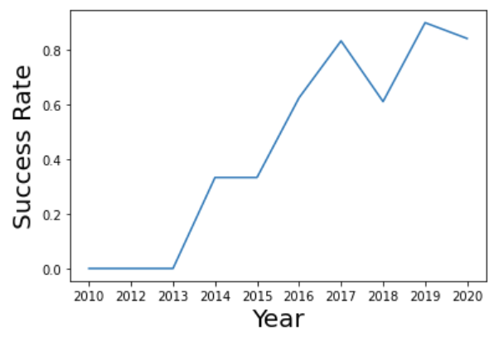
EDA with Data Visualization
Success rate of launches seemed to increase with the flight number (see fig.), therefore created several plots to see what other parameters might have affected this:
Catplot: flight number vs payload mass (coloured by success)
Catplot: flight number and launch site (coloured by success)
Catplot: flight number and target orbit (coloured by success)
Then plotted further graphs looking at relationships between these parameters:
Catplot: payload mass and launch site (coloured by success)
Catplot: payload mass and target orbit (coloured by success)
Bargraph: average success rate for each target orbit
https://github.com/Leocadion/IBM-Data-Science-Final-Project/blob/main/jupyter-labs-eda-dataviz.ipynb

Slide 12
EDA with SQL
Performed SQL queries to:
Identify the different launchsites used for flights (SELECT DISTINCT launch_site from spacex)
Select launches from CCAFS LC-40 and SLC-40
Identify the total payload mass carried by boosters launched by NASA (CRS)
Display average payload mass carried by booster version F9 v1.1
List the date when the first successful landing outcome in ground pad was acheived
List the names of the boosters which have success in drone ship and have payload mass greater than 4000 but less than 6000
List the total number of successful and failure mission outcomes
List the names of the booster_versions which have carried the maximum payload mass
List the failed landing_outcomes in drone ship, their booster versions, and launch site names for in year 2015
Rank the count of landing outcomes (such as Failure (drone ship) or Success (ground pad)) between the date 2010-06-04 and 2017-03-20, in descending order
https://github.com/Leocadion/IBM-Data-Science-Final-Project/blob/main/jupyter-labs-eda-sql-coursera.ipynb

Slide 13
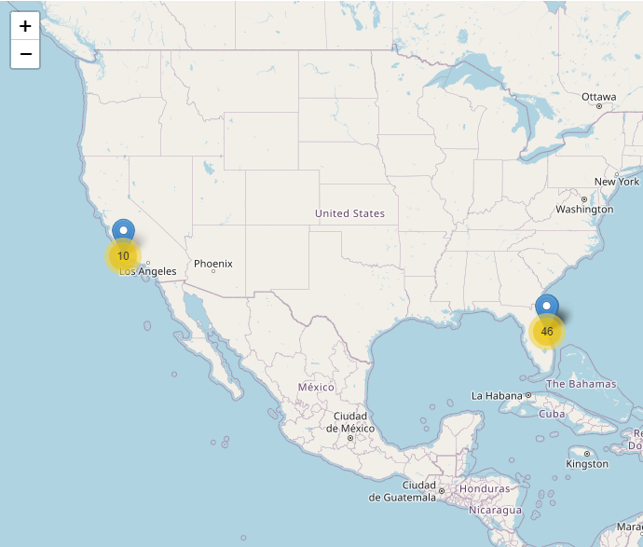
Build an Interactive Map with Folium
Created an interactive map of all Falcon 9 launch sites to identify any geographical determinants of launch success:
Added markers of launch sites
Added markers indicating failed/successful launches at each site
Measured distances from launch sites to geographically important locations, such as highways, cities, and coastlines, added corresponding lines and distance markers.
https://github.com/Leocadion/IBM-Data-Science-Final-Project/blob/main/lab_jupyter_launch_site_location.ipynb

Slide 14
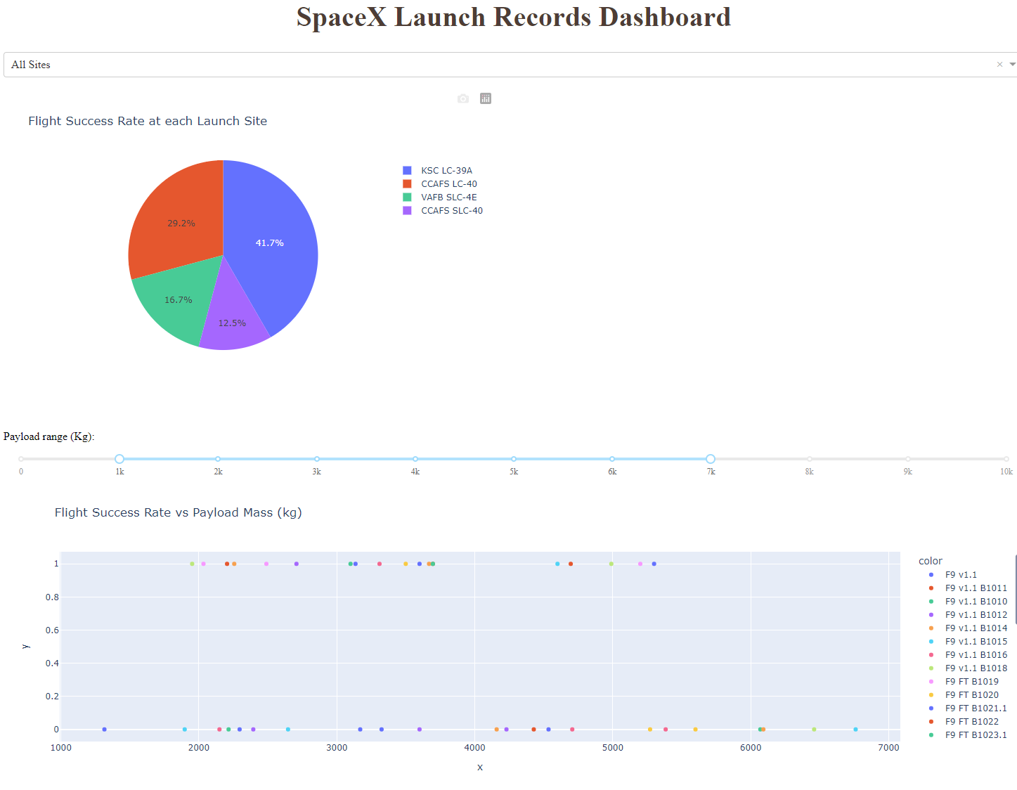
Build a Dashboard with Plotly Dash
Created an online dashboard to facilitate exploration of the relationship between launch site, payload weight, booster type, and success rate
Allows selection of specific launch site via dropdown bar
Shows launch success rate at specified sites
Also has a scatterplot showing flight success rate vs payload, coloured by booster type
Payload mass range visualised can be adjusted via slider.

Slide 15
Predictive Analysis (Classification)
Tested logistic regression, support vector machine, decision tree and K-nearest neighbour classification algorithms.
Split dataset into test and train subsets (80%/20% split)
Define a range of algorithm parameters (specific for each algorithm)
Perform GridSearchCV to identify best parameters for each algorithm
Use training subset to train each algorithm using the best parameters
Evaluate the accuracy of each algorithm using the test data subset
Compare algorithm scores to identify best algorithm
https://github.com/Leocadion/IBM-Data-Science-Final-Project/blob/main/SpaceX_Machine%20Learning%20Prediction_Part_5.ipynb

Slide 16
Results
Exploratory data analysis results
Interactive analytics demo in screenshots
Predictive analysis results

Slide 17

Section 2

Slide 18
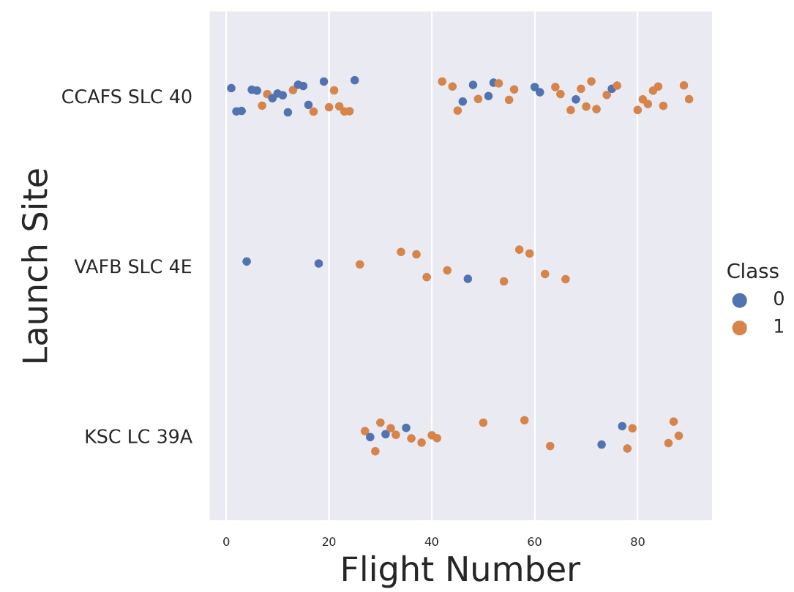
Flight Number vs. Launch Site
The first 25 flights were conducted at CCAFS SLC40, and they were mostly unsuccessful.
After this initial run, then next 15 flights were conducted at KSC LC 39A, and they were more successful in general.
After that, most of the following flights were conducted at CCAFS SLC40 again, most of which were successful, although some still took place at KSC LC 39A
VAFB SLC 4E was used only sporadically, probably when other launch sites were unavailable.

Slide 19
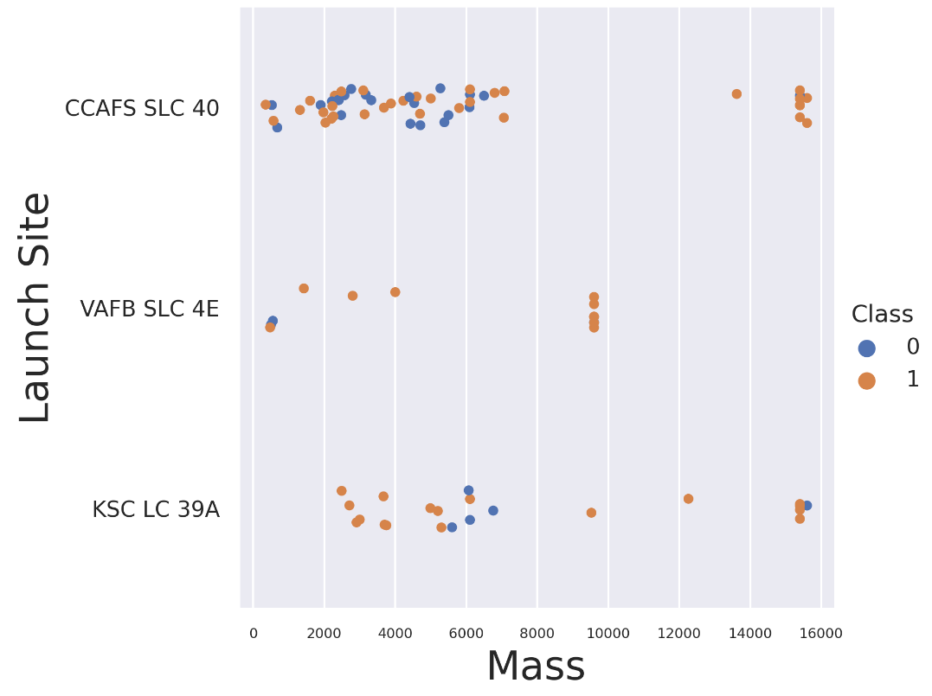
Payload vs. Launch Site
CCAFS SLC 40 is used for both light (up to 8t) and heavy payloads (+13t)
VAFB SLC 4E is used for light and medium, but not heavy payloads
KSC LC 39A used for all payload types

Slide 20
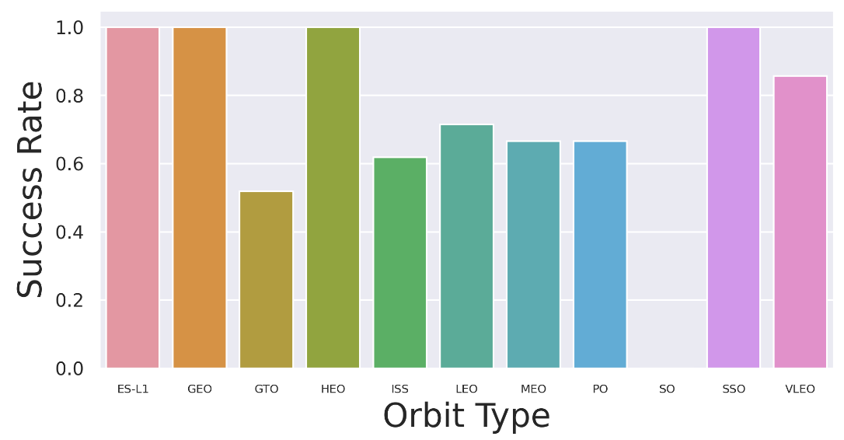
Success Rate vs. Orbit Type
The highest success rate (100%) are for orbit types:
ES-L1, GEO, HEO, SSO
High success rate (80%):
VLEO
Medium success rates (50%-70%):
GTO, ISS, LEO, MEO, PO
0% Success Rate:
SO

Slide 21
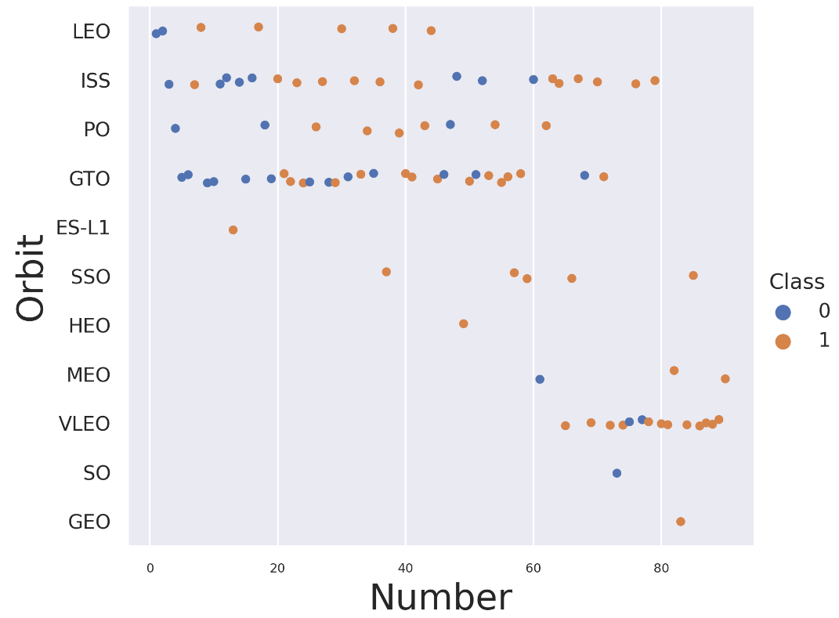
Flight Number vs. Orbit Type
If the data in this chart is cross-referenced to the previous chart (success rate per orbit type), we can see that most orbit types with 100% success rate have only been targeted once, therefore their success rate is not statistically significant (with the exception of SSO)
Seems like initially SpaceX was mostly focused on LEO, ISS, PO, and GTO orbits, but now the most popular orbit is VLEO, which has a very high success rate
The ISS orbit initially had an interval of successful runs from flight number 20 – 40. The first chart (launch site vs flight number) shows that for these flights KSC LC39 was used

Slide 22
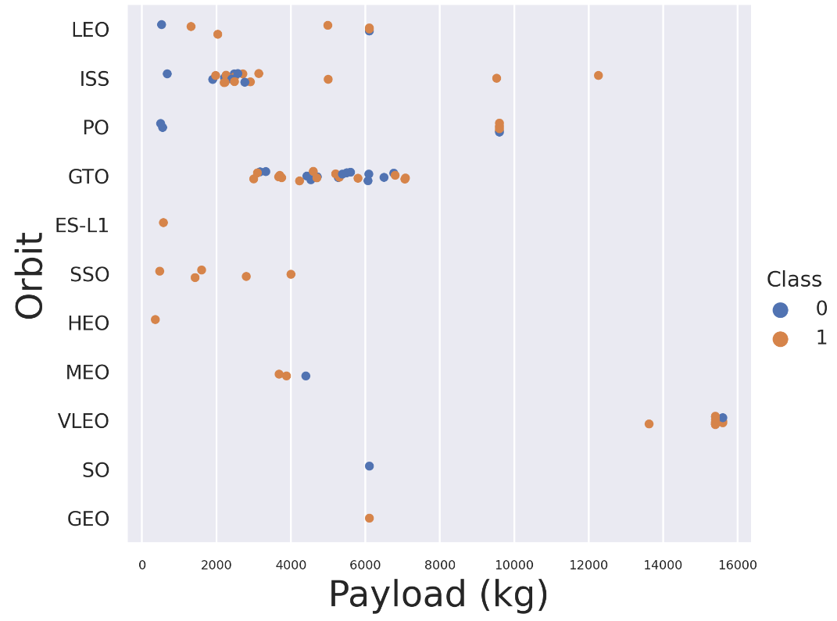
Payload vs. Orbit Type
All heavy payloads (+13t) were targeted only to VLEO orbit
Medium payloads (8-13t) were targeted to ISS and PO orbits only
All other orbits were used for light payloads only (up to 8t)
HEO and ES-L1 orbits were used only for very light payloads (less than 1t)

Slide 23
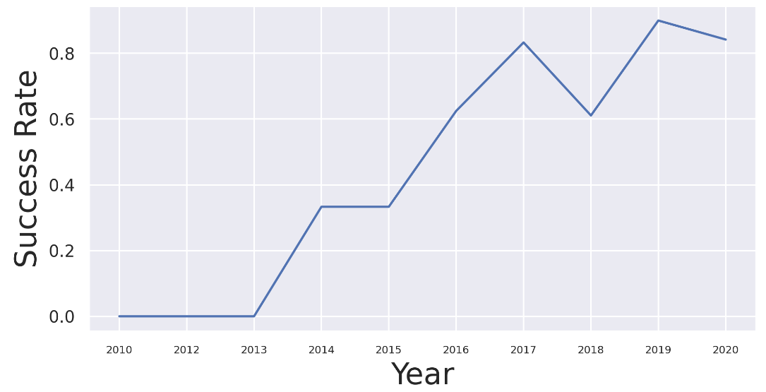
Launch Success Yearly Trend
The graph shows that the average flight success rate has been steadily increasing every year since 2013
Previous graphs did not give a clear indication of why this might be, so other methods, such as machine learning are necessary to estimate the impact of each variable on the success rate

Slide 24
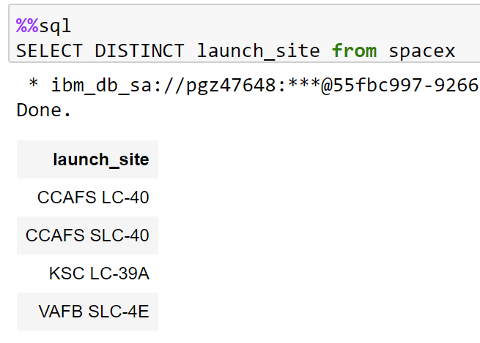
All Launch Site Names
The SQL query returned all distinct values in the launch_site column of our database
This identified three unique launch sites in our data

Slide 25
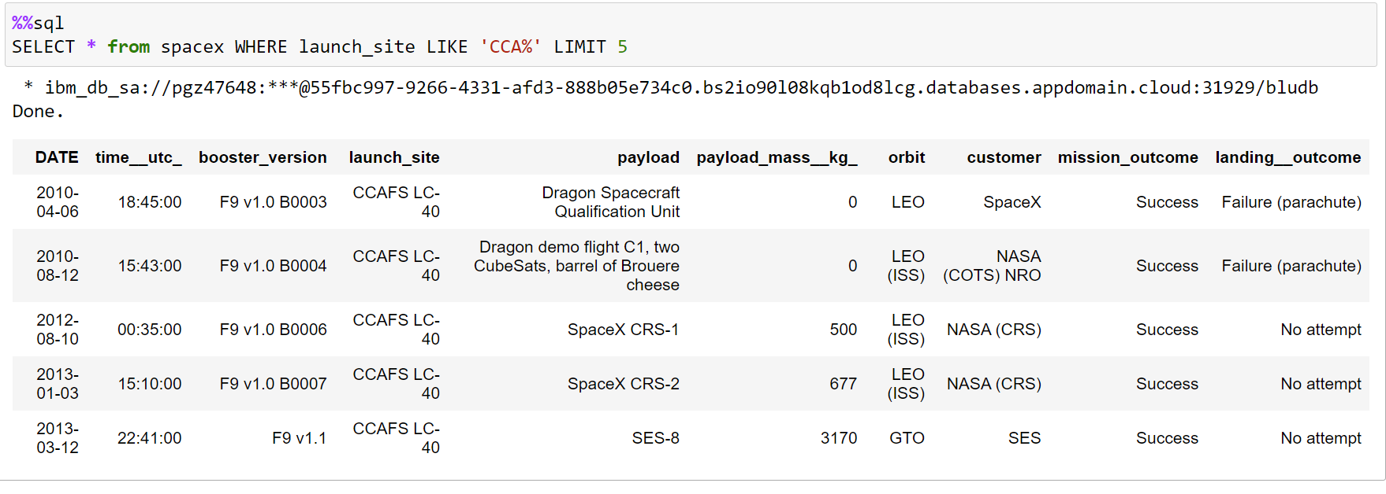
Launch Site Names Begin with 'CCA'
The query returned 5 records from our database (LIMIT 5) where launch site started with CCA by using LIKE ‘CCA%’ (where % is a wildcard)

Slide 26
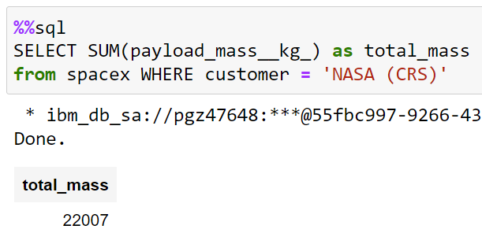
Total Payload Mass
Used function SUM() to return total payload mass where client was NASA
SUM() was limited to NASA payloads by using WHERE customer = ‘NASA (CRS)’

Slide 27
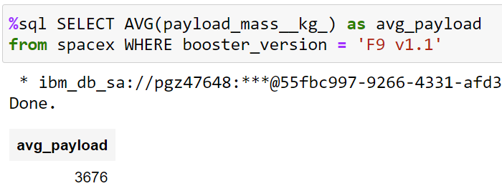
Average Payload Mass by F9 v1.1
Calculated the average payload mass carried by booster version F9 v1.1
Used function AVG()
Limited to a specific booster version by using WHERE booster_version = ‘F9 v1.1’

Slide 28
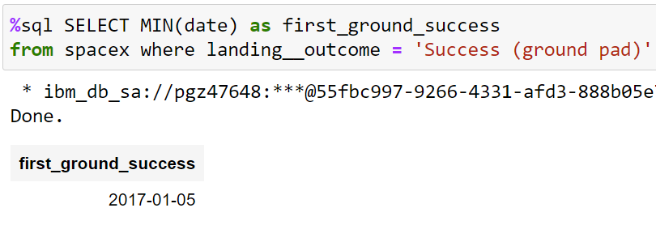
First Successful Ground Landing Date
Found the date of the first successful landing outcome on ground pad:
Used MIN() function on date column
Limited landing outcome to ground pad by using WHERE

Slide 29
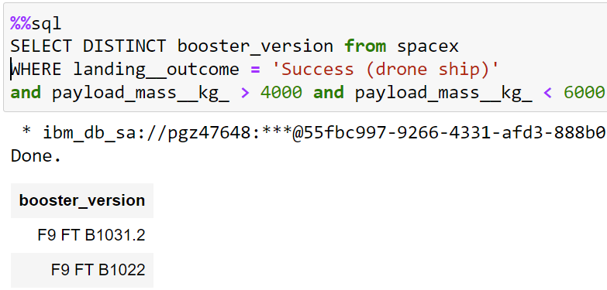
Successful Drone Ship Landing with Payload between 4000 and 6000
Found the names of boosters which have successfully landed on drone ship and had payload mass greater than 4000 but less than 6000
Used DISTINCT to skip duplicates
Limited query to a specific landing outcome by using WHERE
Specified a certain mass range by using WHERE and a set of conditions

Slide 30
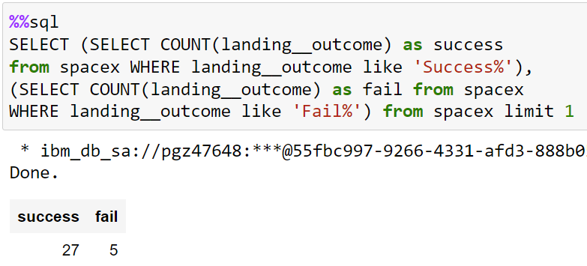
Total Number of Successful and Failure Mission Outcomes
Calculate the total number of successful and failure mission outcomes within the database:
Created a nested query for both successful and failed missions where used COUNT() and wildcard with LIKE to filter out relevant entries

Slide 31
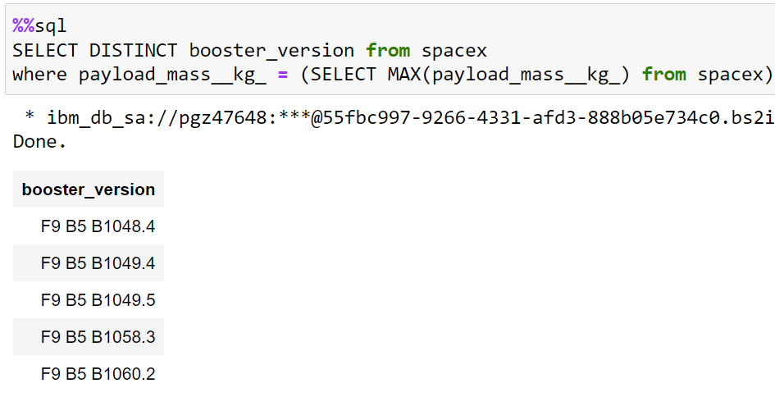
Boosters Carried Maximum Payload
Listed the names of the booster which have carried the maximum payload mass:
Remove duplicate entries by DISTINCT
Created a nested query to allow the usage of a MAX() function within a condition

Slide 32
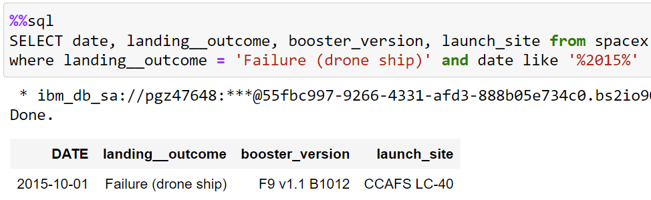
2015 Launch Records
Listed the failed landing_outcomes in drone ship, their booster versions, and launch site names for in year 2015:
Selected specific columns from all entries with specific conditions for landing outcome and date with a wildcard

Slide 33
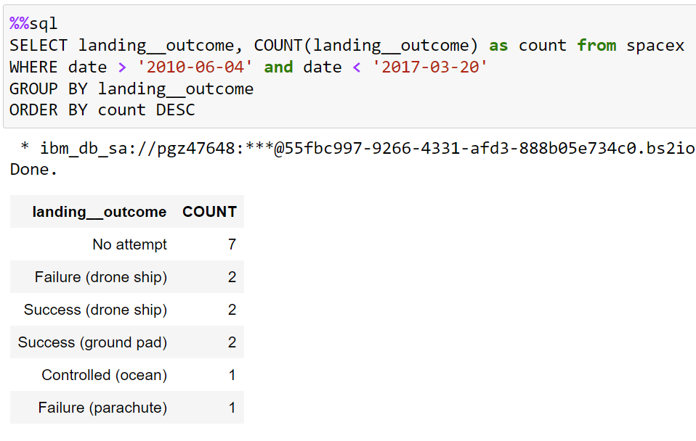
Rank Landing Outcomes Between 2010-06-04 and 2017-03-20
Ranked the count of landing outcomes between the date 2010-06-04 and 2017-03-20, in descending order:
Used COUNT() to get total number of each landing outcome
Restricted query to a specific date range with WHERE
Grouped results by landing outcome using GROUP BY
Ordered by using ORDER BY DESC

Slide 34

Section 3

Slide 35
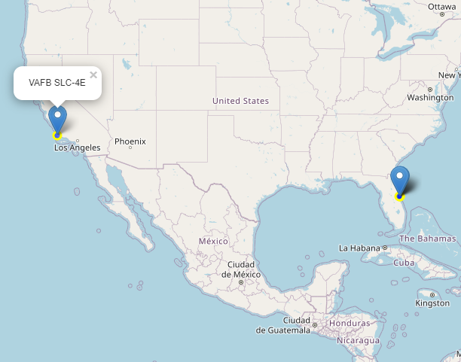
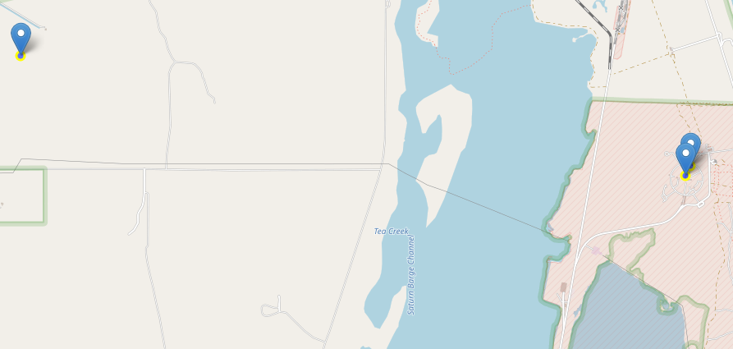
Falcon 9 Launch Sites
There are 4 launch sites used for Falcon 9 flights
VAFB SLC4-E located on the west coast, California
The other three (KSC LC-39A, CCAFS LC-40 and CCAFS SLC-40) are all located very close to one another, on the east coast, Florida, at the Cape Canaveral Space Force Station
The VAFB SLC4-E site is located further north than the other sites

Slide 36
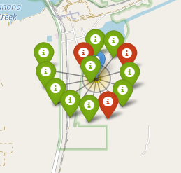
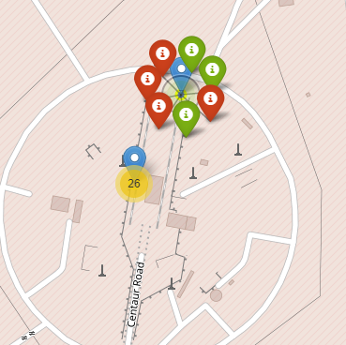
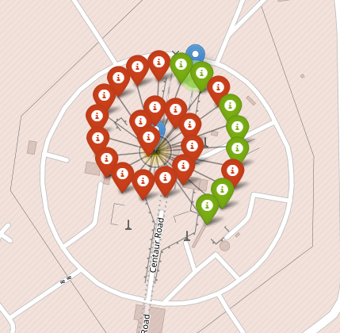
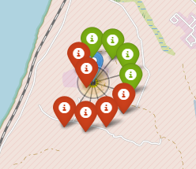
Launch Outcomes at Each Site
Most launches were conducted at CCAFS LC-40, about a third of which were unsuccessful
The CCAFS SLC-40, which is located right next to it, had the least launches , but about a half of them were successful (probably less statistically significant)
KSC LC-39A, which is slightly to the east and further away from the coastline had a very high success rate
KSC LC-39A
CCAFS SLC-40
CCAFS LC-40
VAFB SLC4-E

Slide 37
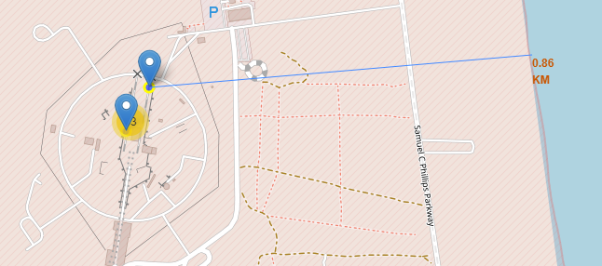
Launch Site Distance from the Coastline
The CCAFS launch sites are less than a kilometer away from the coastline
This might explain their relatively low success rates observed in the previous slide

Slide 38

Section 4

Slide 39
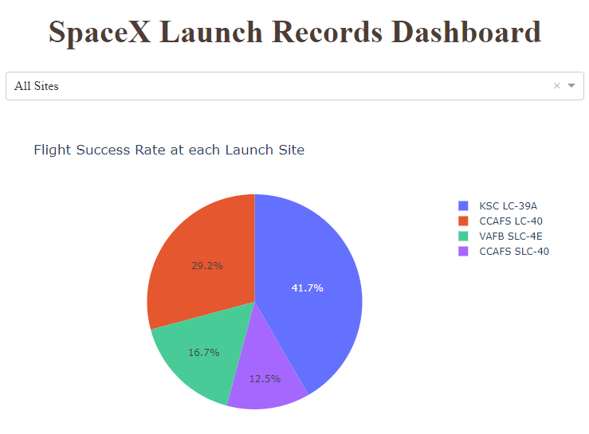
Successful flights at each Launch Site
Similarly to the data visualised on a map, the pie chart showing successful flights at all launch sites indicates that KSC LC-39A launch site had the highest amount of successful launches (41.7%)
Lowest amount was for CCAFS SLC-40 (12.5% of all successful flights)
The CCAFS LC-40, which was used for most of the launches, had the 2nd highest success rate (29.2%)

Slide 40
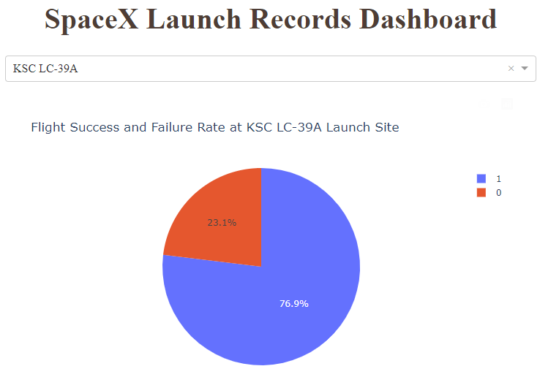
Successful flights at KSC LC-39A
The most successful launch site, KSC LC-39A, had a flight success rate of 76.9%

Slide 41
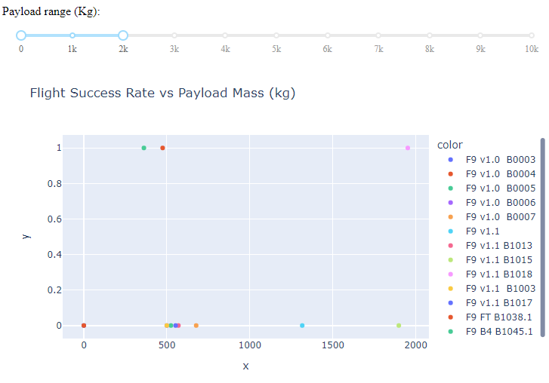
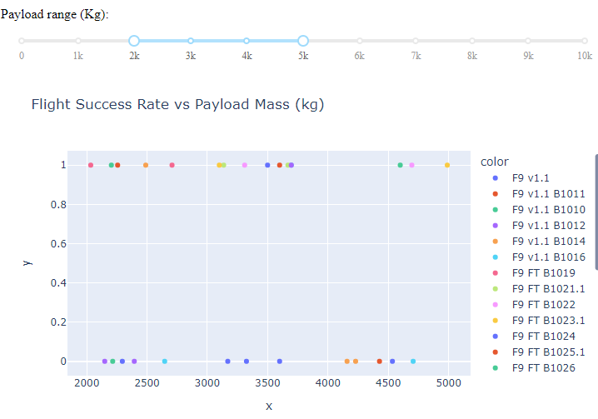
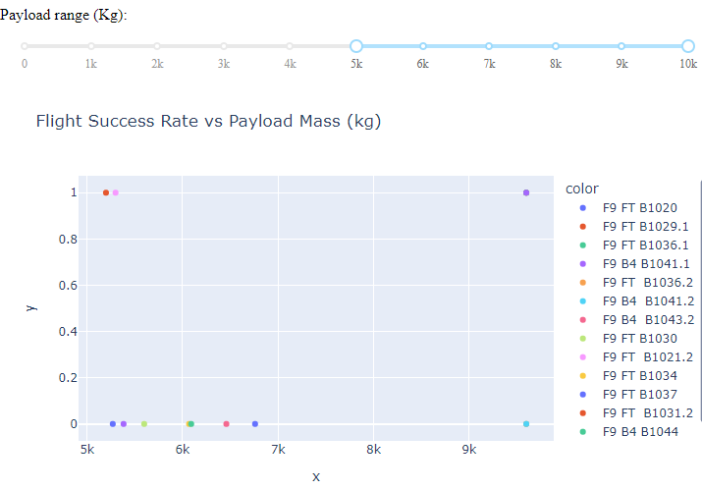
Flight success rate at different payloads
Selecting only the highest payloads (5-10t) showed that most of the flights were unsuccessful
Similarly, selecting the lowest payloads (up to 2t) showed that most flights were again unsuccessful
Most of the successful flights were found in the payload mass range between 2 and 5t

Slide 42

Section 5

Slide 43
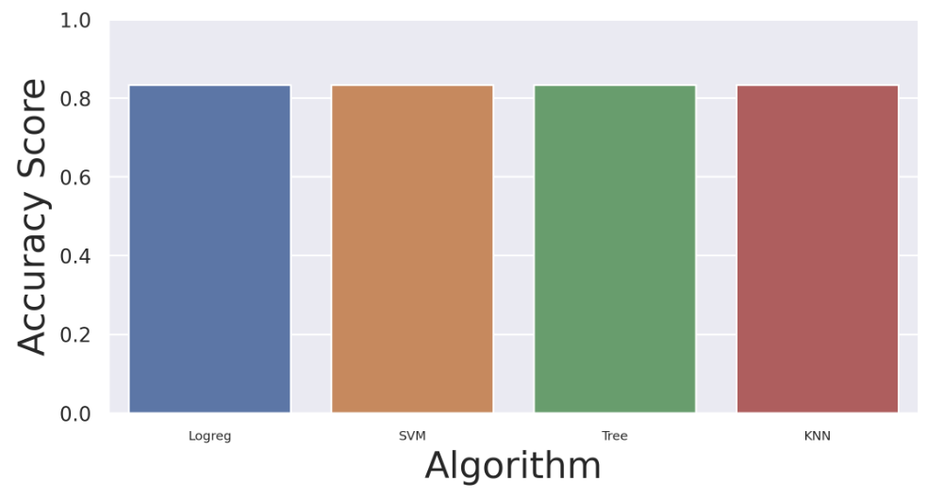
Classification Accuracy
After finding the best parameters using GridSearchCV, all algorithms had the same accuracy of 0.8333

Slide 44
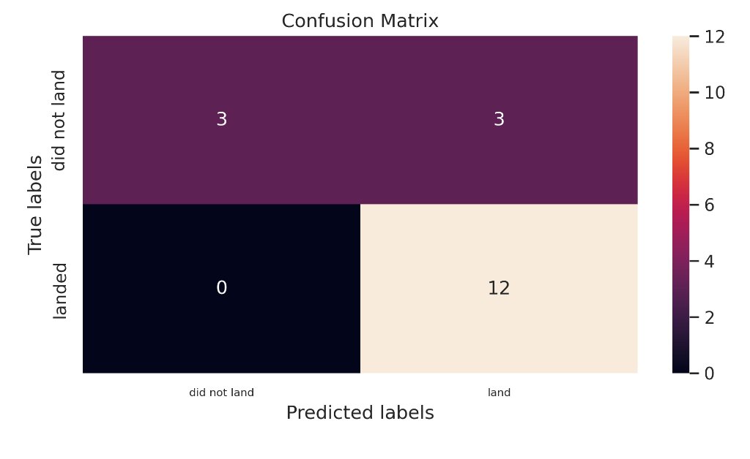
Confusion Matrix
The algorithms all correctly predicted all 12 positive outcomes, with zero false positives
The algorithms were slightly worse at predicting negative outcomes, with accuracy being only 50%

Slide 45
Conclusions
If optimised parameters are used for different classification algorithms , they will tend to give similar results
We only had 18 data points in our testing set, which would be too small to detect any divergences in the classification algorithms, resulting in similar accuracy scores
Our models seemed to be biased towards predicting positive outcomes, with a high false positive rate, this might reflect the size of our dataset
83% success rate is still quite high, so we can use it to make predictions about whether a launch will be successful or not, but more data and more optimisation is required

Slide 46


